Slide 1
Sentiment Analysis
What is Sentiment Analysis?

Slide 2
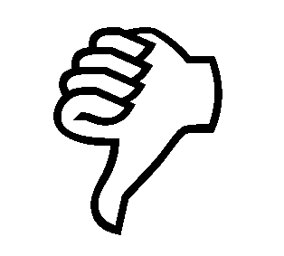

Positive or negative movie review?
unbelievably disappointing
Full of zany characters and richly applied satire, and some great plot twists
this is the greatest screwball comedy ever filmed
It was pathetic. The worst part about it was the boxing scenes.

Slide 3
Google Product Search
a

Slide 4
Bing Shopping
a

Slide 5
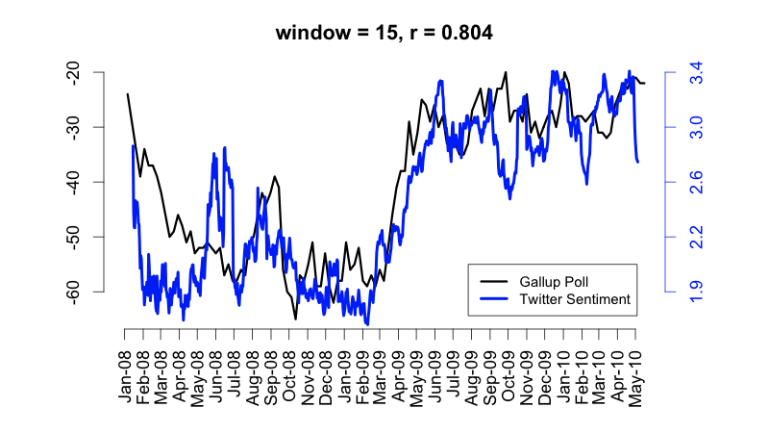
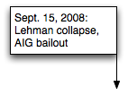
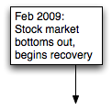
Twitter sentiment versus Gallup Poll of Consumer Confidence
Brendan O'Connor, Ramnath Balasubramanyan, Bryan R. Routledge, and Noah A. Smith. 2010. From Tweets to Polls: Linking Text Sentiment to Public Opinion Time Series. In ICWSM-2010
Notes:
Thanks to Brendan O’Connor and Noah Smith (email, 1/18/12) for permission to use this figure.

Slide 6
Twitter sentiment:
Johan Bollen, Huina Mao, Xiaojun Zeng. 2011. Twitter mood predicts the stock market,
Journal of Computational Science 2:1, 1-8. 10.1016/j.jocs.2010.12.007.
Notes:
Thanks to Johan Bollen (email, 1/18/12) for permission to use this figure.

Slide 7
Bollen et al. (2011)
CALM predicts DJIA 3 days later
At least one current hedge fund uses this algorithm
Dow Jones
CALM
Notes:
Thanks to Johan Bollen (email, 1/18/12) for permission to use this figure.

Slide 8
Target Sentiment on Twitter
Twitter Sentiment App
Alec Go, Richa Bhayani, Lei Huang. 2009. Twitter Sentiment Classification using Distant Supervision

Slide 9
Sentiment analysis has many other names
Opinion extraction
Opinion mining
Sentiment mining
Subjectivity analysis

Slide 10
Why sentiment analysis?
Movie: is this review positive or negative?
Products: what do people think about the new iPhone?
Public sentiment: how is consumer confidence? Is despair increasing?
Politics: what do people think about this candidate or issue?
Prediction: predict election outcomes or market trends from sentiment

Slide 11
Scherer Typology of Affective States
Emotion: brief organically synchronized … evaluation of a major event
angry, sad, joyful, fearful, ashamed, proud, elated
Mood: diffuse non-caused low-intensity long-duration change in subjective feeling
cheerful, gloomy, irritable, listless, depressed, buoyant
Interpersonal stances: affective stance toward another person in a specific interaction
friendly, flirtatious, distant, cold, warm, supportive, contemptuous
Attitudes: enduring, affectively colored beliefs, dispositions towards objects or persons
liking, loving, hating, valuing, desiring
Personality traits: stable personality dispositions and typical behavior tendencies
nervous, anxious, reckless, morose, hostile, jealous

Slide 12
Scherer Typology of Affective States
Emotion: brief organically synchronized … evaluation of a major event
angry, sad, joyful, fearful, ashamed, proud, elated
Mood: diffuse non-caused low-intensity long-duration change in subjective feeling
cheerful, gloomy, irritable, listless, depressed, buoyant
Interpersonal stances: affective stance toward another person in a specific interaction
friendly, flirtatious, distant, cold, warm, supportive, contemptuous
Attitudes: enduring, affectively colored beliefs, dispositions towards objects or persons
liking, loving, hating, valuing, desiring
Personality traits: stable personality dispositions and typical behavior tendencies
nervous, anxious, reckless, morose, hostile, jealous

Slide 13
Sentiment Analysis
Sentiment analysis is the detection of attitudes
“enduring, affectively colored beliefs, dispositions towards objects or persons”
Holder (source) of attitude
Target (aspect) of attitude
Type of attitude
From a set of types
Like, love, hate, value, desire, etc.
Or (more commonly) simple weighted polarity:
positive, negative, neutral, together with strength
Text containing the attitude
Sentence or entire document

Slide 14
Sentiment Analysis
Simplest task:
Is the attitude of this text positive or negative?
More complex:
Rank the attitude of this text from 1 to 5
Advanced:
Detect the target, source, or complex attitude types

Slide 15
Sentiment Analysis
Simplest task:
Is the attitude of this text positive or negative?
More complex:
Rank the attitude of this text from 1 to 5
Advanced:
Detect the target, source, or complex attitude types

Slide 16
Sentiment Analysis
What is Sentiment Analysis?

